Slide 1


K.RAMAKRISHNAN COLLEGE OF TECHNOLOGY
(AUTONOMOUS), TRICHY.
Parcel Tracking System
PRESENTED
VISWAKMANIMANNAN
2303811710421183
SUPERVISOR
Mr. A. Malarmannan, M.E.,
AP/CSE.

Slide 2
PRESENTATION OVERVIEW
Objective
Project Introduction
Problem Statement
Methodologies (Programming concepts relevant to problem statement)
Architecture of the proposed system
List of Modules
Merits
Results and Discussion
Queries

Slide 3
OBJECTIVE
The objective of a Parcel Tracking System is to provide a seamless, efficient, and transparent solution for monitoring parcels throughout the delivery process.
It enables real-time tracking, allowing customers to know the exact location and status of their packages from dispatch to delivery. By automating the tracking process, the system minimizes human error and enhances operational efficiency.
Parcel Tracking System aims to streamline the entire delivery process, ensuring customer satisfaction.

Slide 4
PROJECT INTRODUCTION
Parcel tracking is an essential part of modern logistics operations. In today’s fast-paced world, customers expect timely deliveries, and logistics companies need to optimize their processes to meet this demand.
A tracking system provides customers with a means to monitor the journey of their parcels from dispatch to delivery, increasing trust and improving customer experience.
the Parcel Tracking System serves as a vital solution that enhances visibility, communication, and security within the delivery process, making it an indispensable part of modern logistics operations.

Slide 5
PROBLEM STATEMENT
The problem addressed by a Parcel Tracking System revolves around the challenges of ensuring the timely, secure, and accurate delivery of parcels in a complex logistics network.
Moreover, businesses struggle to optimize their resources, monitor performance, and provide accurate delivery updates.
Parcel Tracking System is needed to provide real-time tracking, streamline communication, and ensure transparency and security throughout the parcel's journey, ultimately improving operational efficiency and customer satisfaction.

Slide 6
METHODOLOGIES
Real-Time Tracking Technology
Cloud-Based System
Data Analytics and Reporting
Security Protocols
Feedback Mechanisms
Feedback Mechanisms

Slide 7
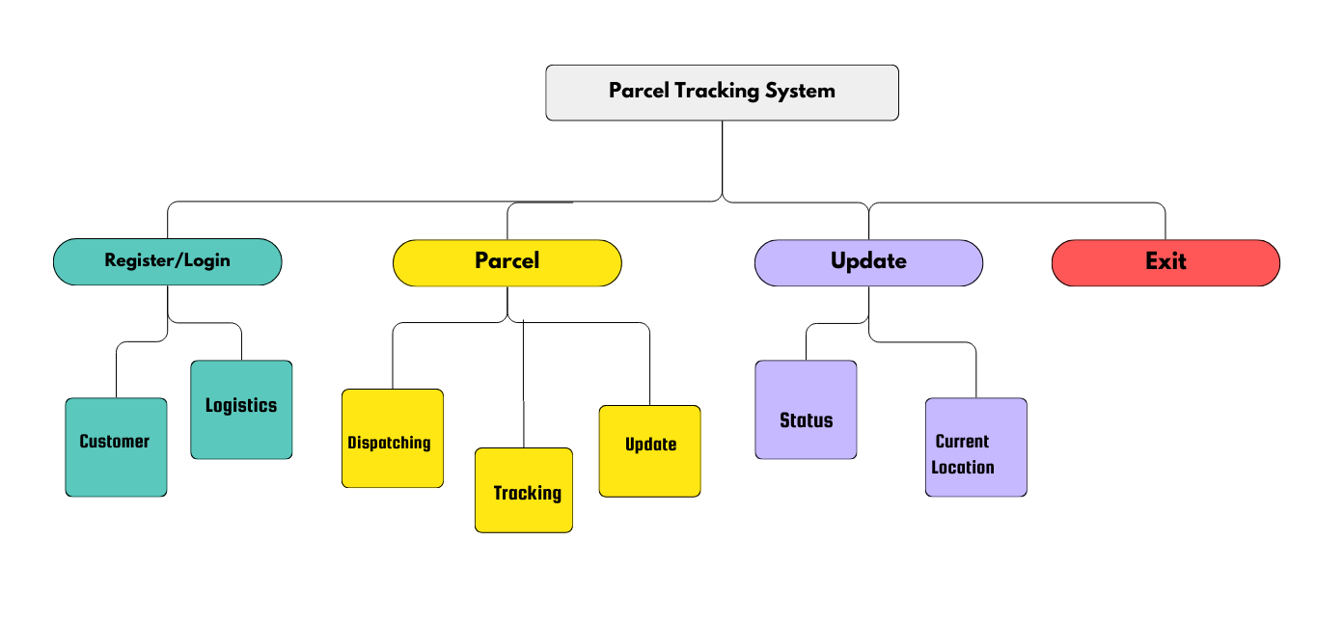
ARCHITECTURE OF THE PROPOSED SYSTEM

Slide 8
LIST OF MODULES
Parcel Management Module
User Management Module
Payment Calculation Module
Tracking Module
Data Storage Module

Slide 9
MERITS
Real-Time Tracking: The system allows customers and businesses to monitor parcels in real-time, providing up-to-date information on the package’s location and estimated delivery time.
Improved Customer Experience: By offering easy access to tracking information via websites, mobile apps, or SMS notifications, customers.
Increased Efficiency and Accuracy: Automation reduces human error, streamlining the tracking process.
International Shipment Support: A Parcel Tracking System can support cross-border tracking, providing visibility for international shipments.

Slide 10
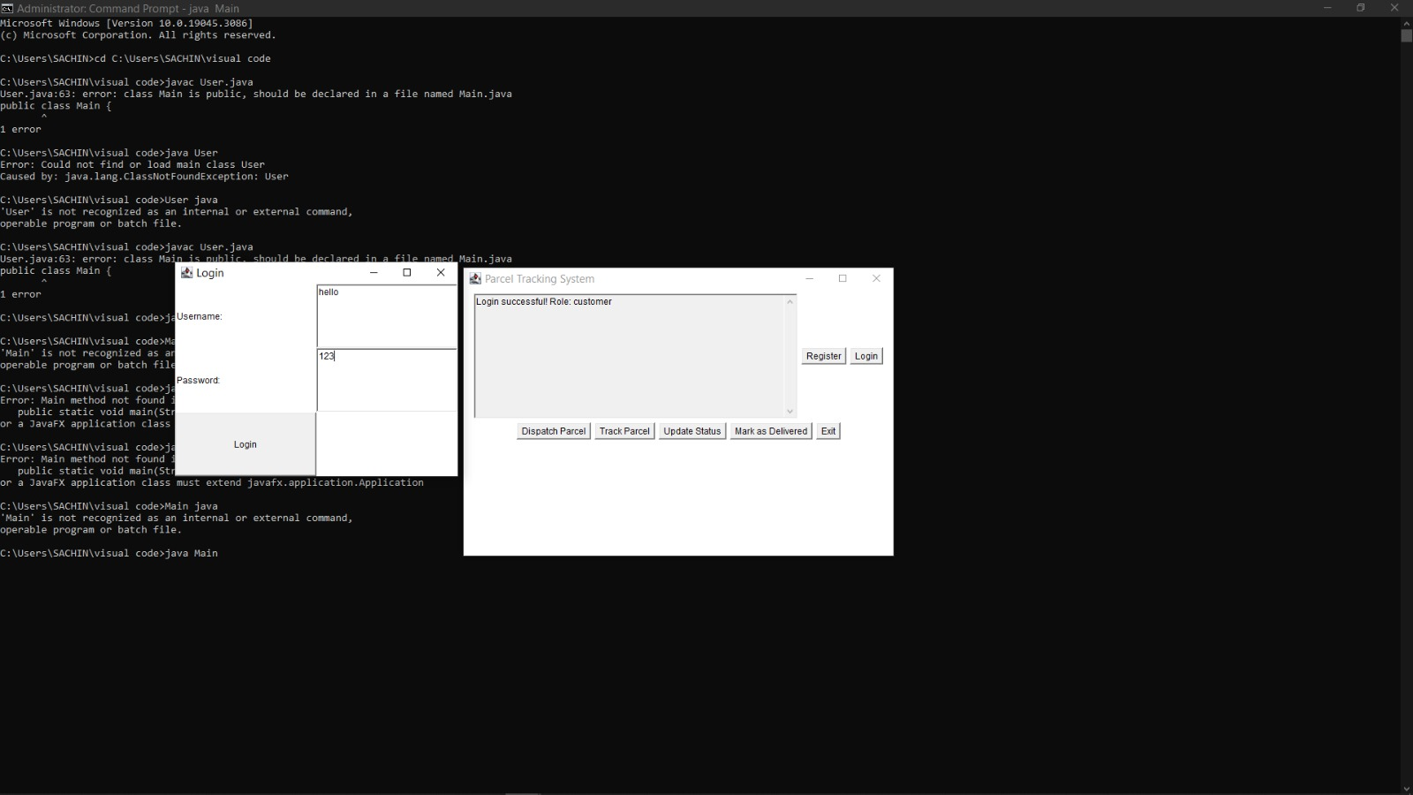
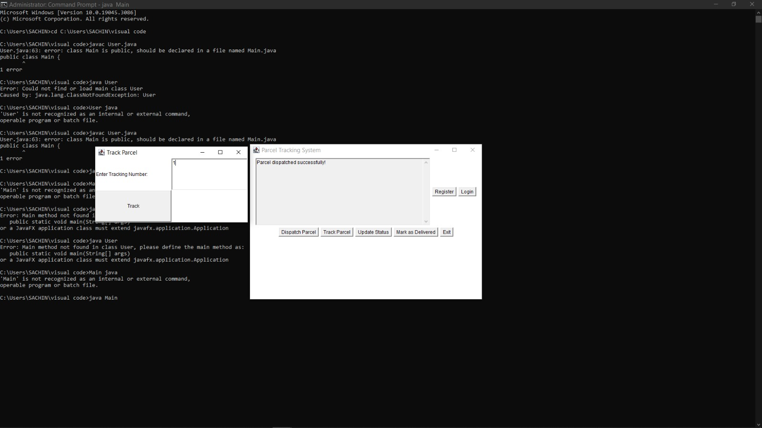

RESULTS AND DISCUSSION

Slide 11
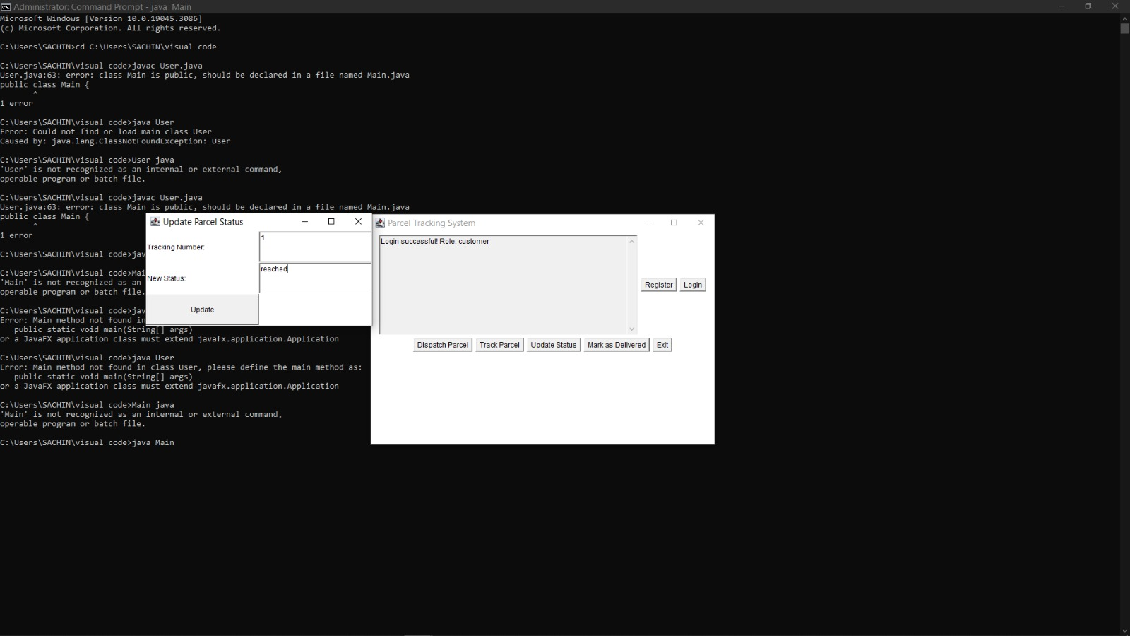
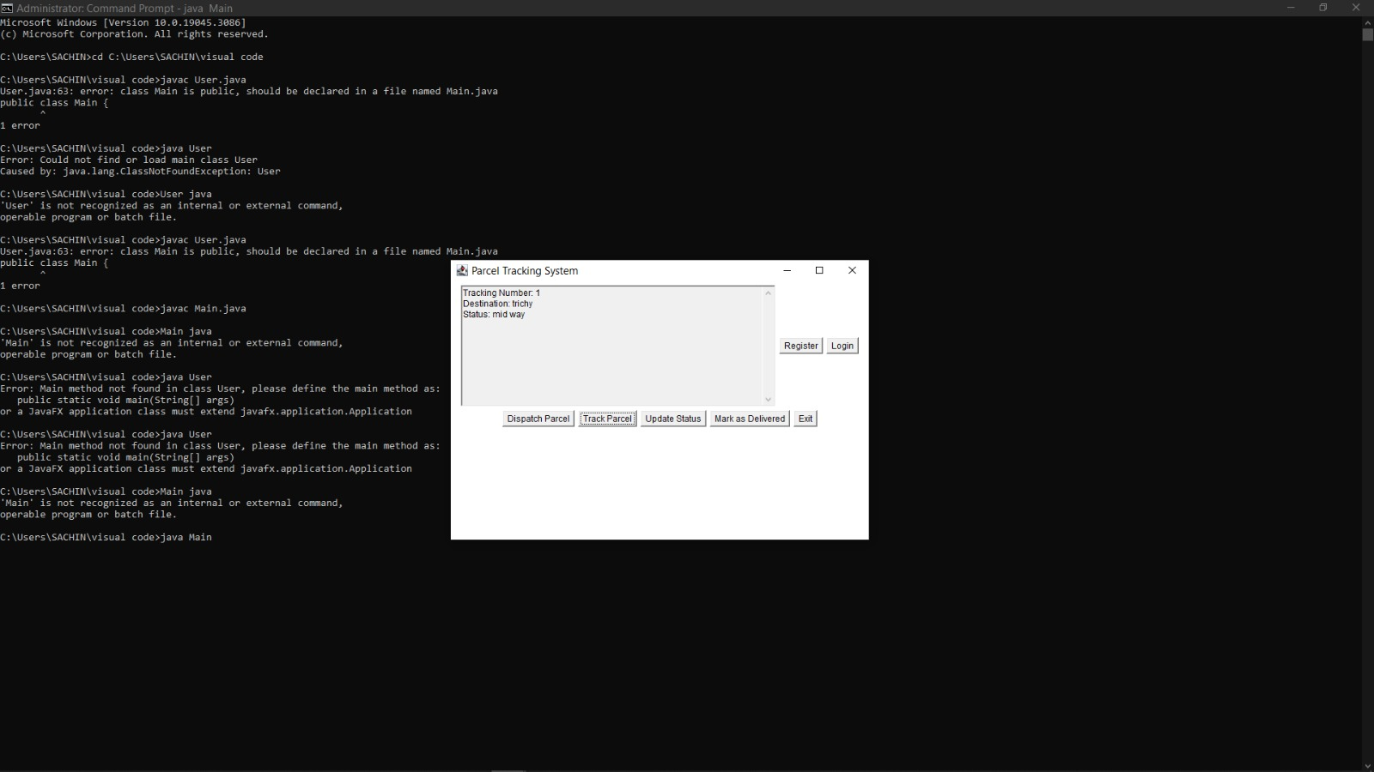

RESULTS AND DISCUSSION
2/7/20

Slide 12
QUERIES ?

